Slide 2
Timeline
Data
Code Setup
Analysis
Communication
Codesign with Initial Drafts
Polish
Codesign Round 2
Polished Designs for Community Event
Deliver One-Pagers
Health Surveys
Understand Survey Goals
Comparable Artifacts Research
Create New Survey
Distribute New Survey @ Event
Documentation
Website
Status Refresh
Codesign
2/13
PR 1
4/1 PR 2
5/6
Final
Notes:
JC

Slide 3
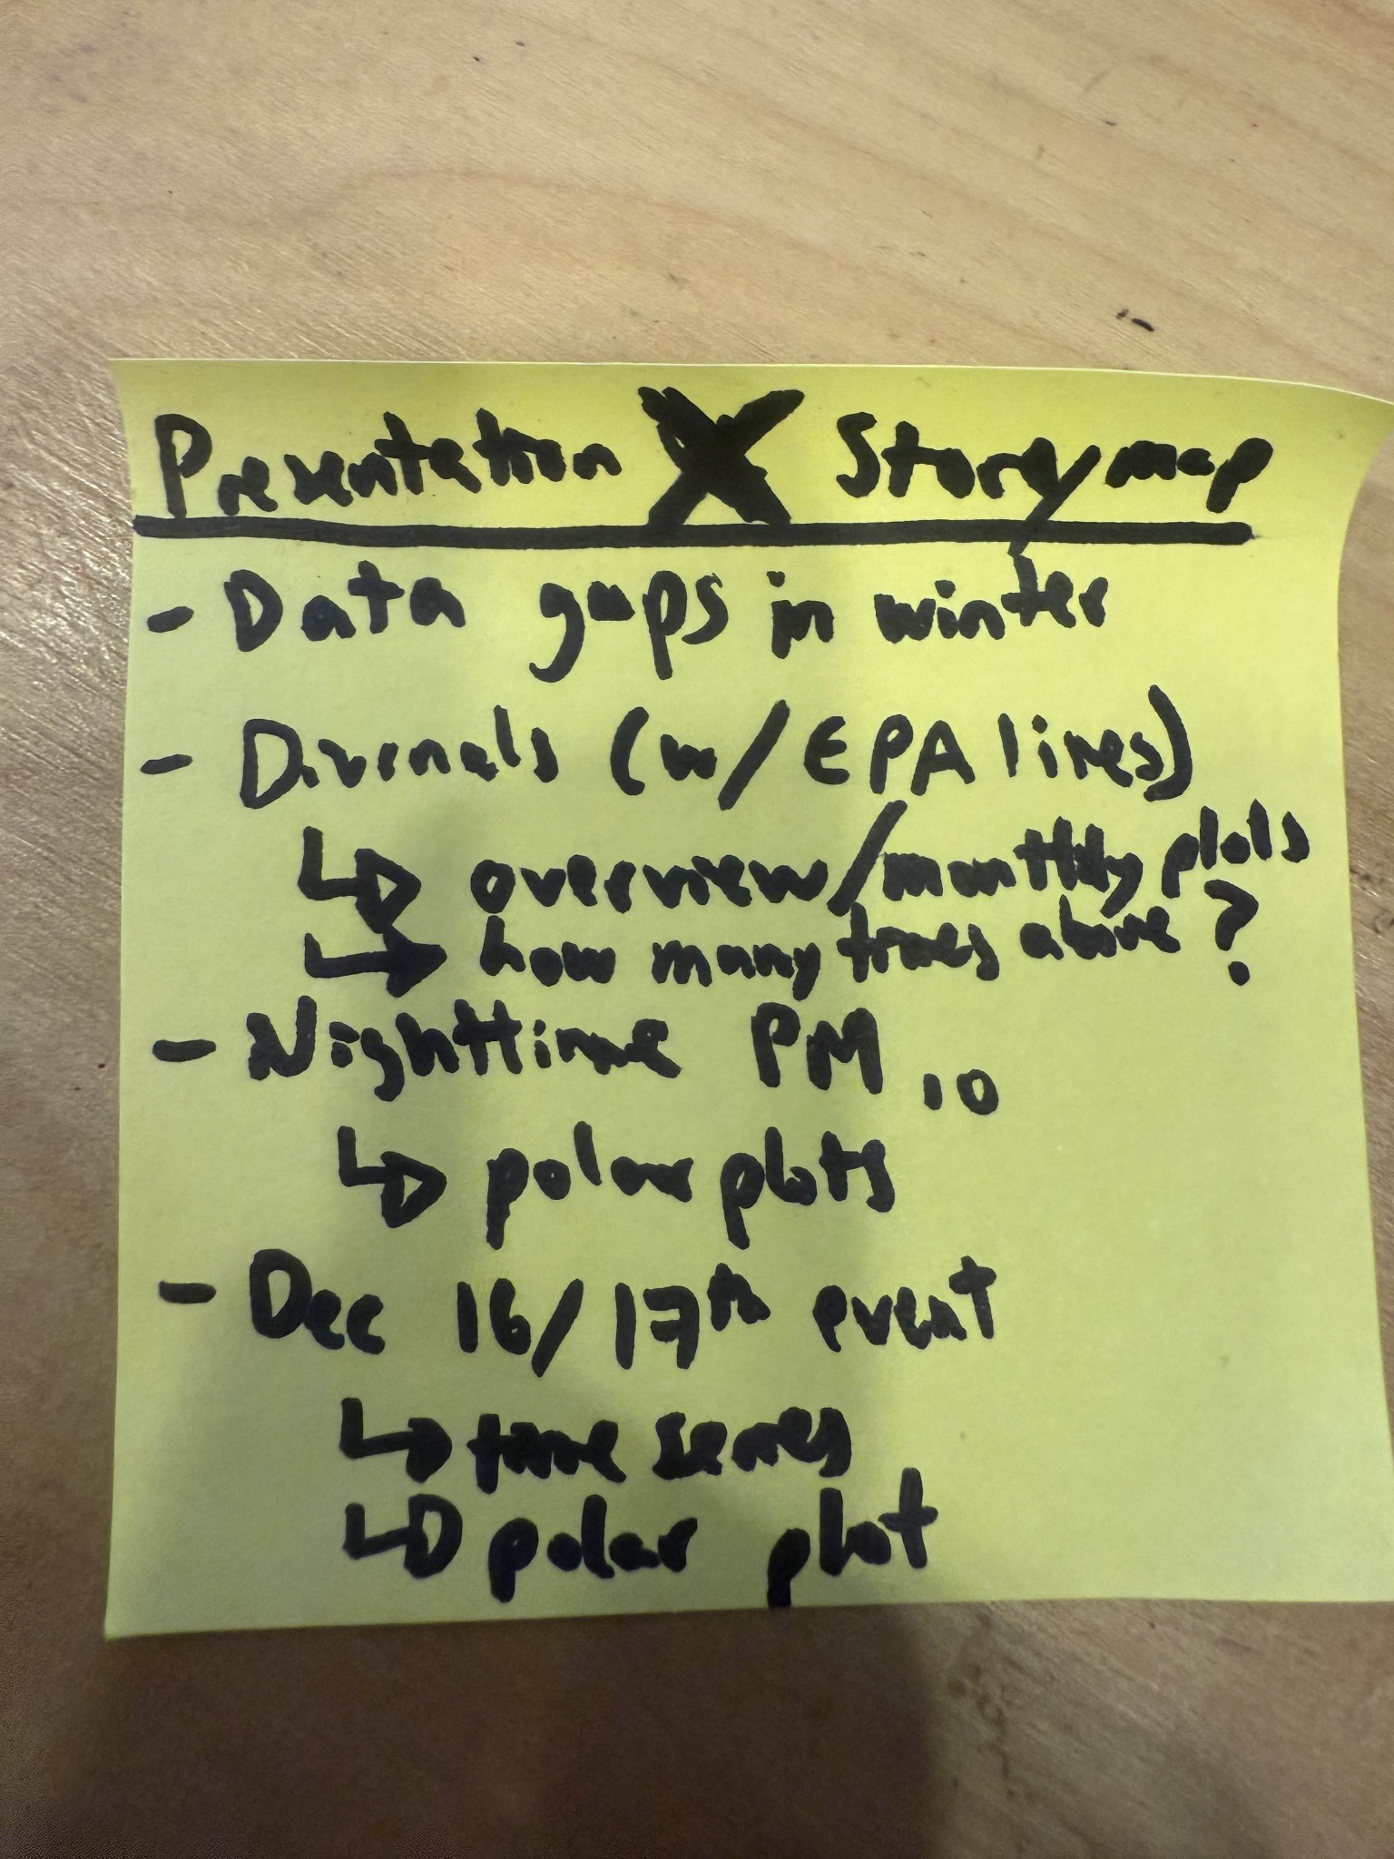
From post it
Data gap in winter ( done )
Dirernals (w/ epa lines)
Overview /monthly plots
How many times above
Nighttime Pm10
Polarplots
Dec 16/17 event
Time survey
D polar plot

Slide 4
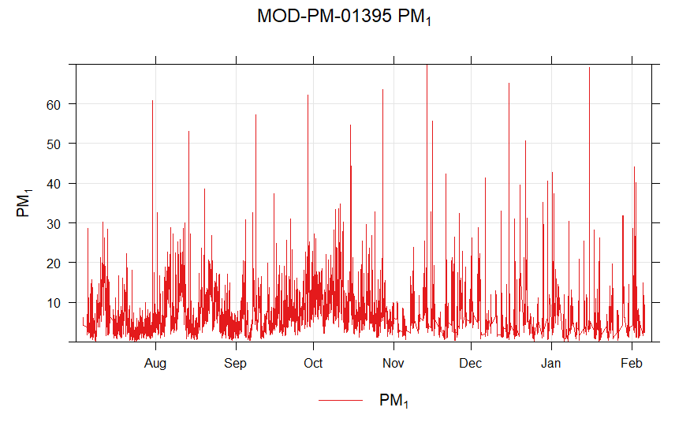
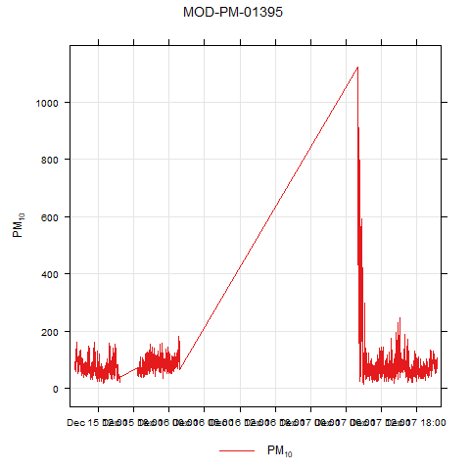
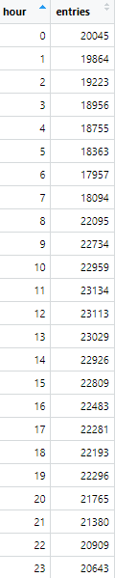
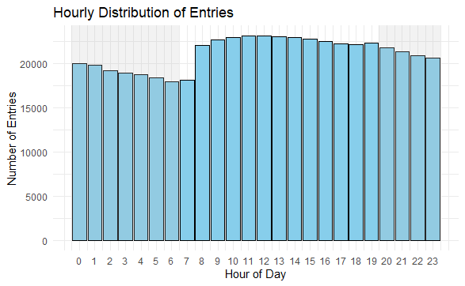
Missing info from sensors
Notes:
Quanti q solar panel battery
Case study of 2 days- event what will they do
Diurnal - when they are bad
Where it coming from - the bad things
Keep it like at most 4 slides
What will they do with the data if we give it to you

Slide 5
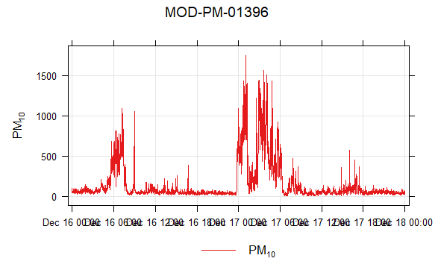
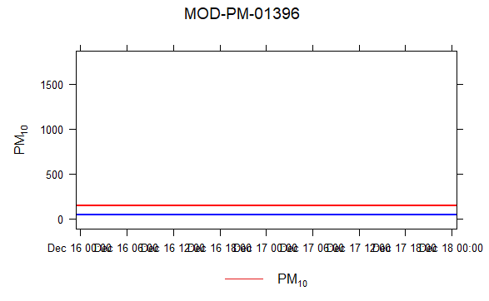
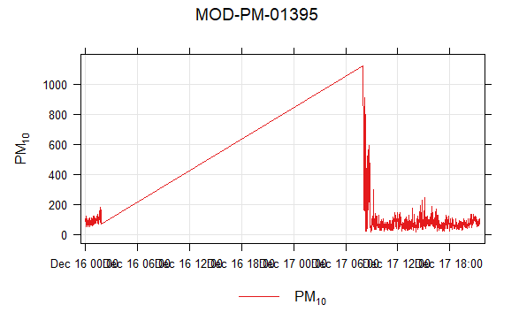
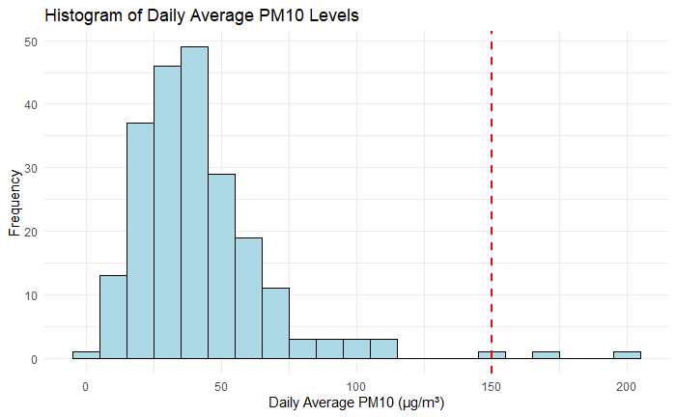
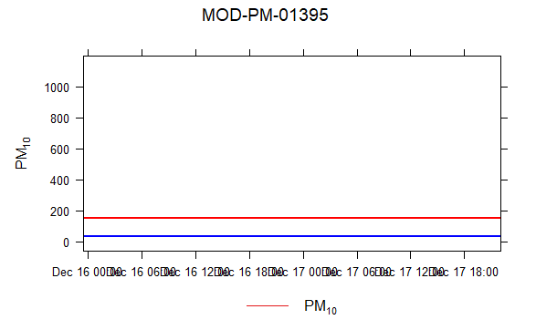
An Increase in PM10
From 12/16-12/18
Blue line - EPA PM 10 Limit
Red line - Average levels without 12/16-12/18 Dat
“EPA is retaining the existing primary 24-hour standard for coarse particles at 150 µg/m3. An area meets the 24-hour PM10 standard if it does not exceed the 150 µg/m3 level more than once per year on average over a three-year period.”
7/31* 12/17 12/18
Notes:
7/31 - 145.1641 not above but close

Slide 6
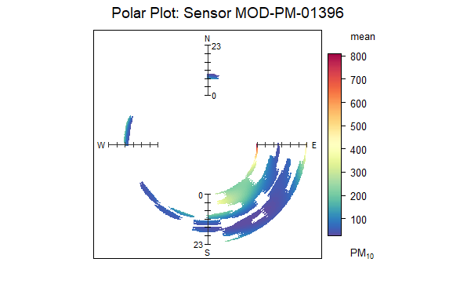
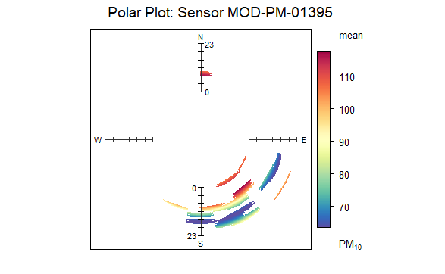
Polar Plots 12/16-12/18

Slide 7
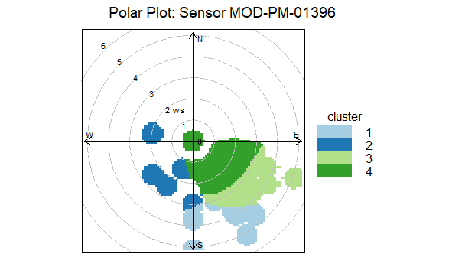
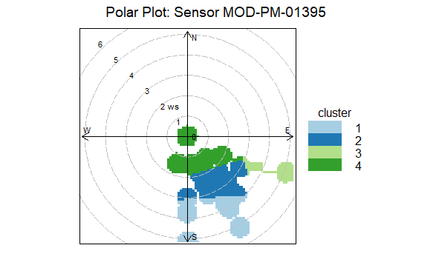
Polar Plots 12/16-12/18
Notes:
Starter with time series - first pass at analysis - diurnal profile; be explicit what it answers
Cal plot

Slide 8
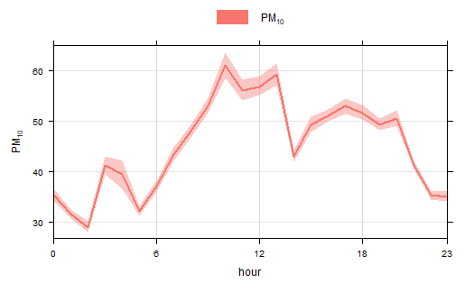
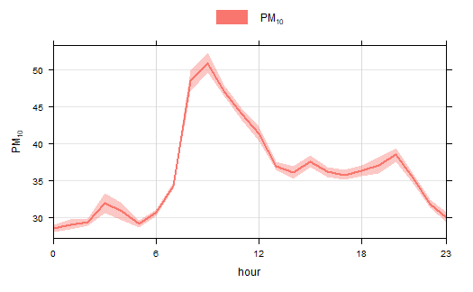
Diurnal Profiles pm10
1396
1395

Slide 9
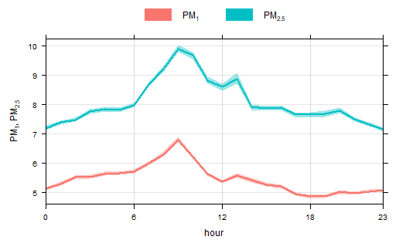
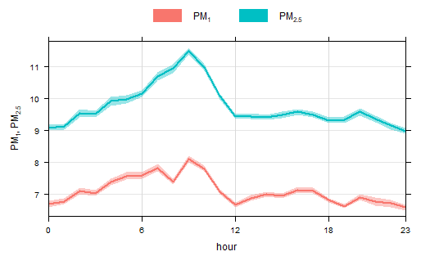
Diurnal Profiles pm1,2.5
1396
1395

Slide 10
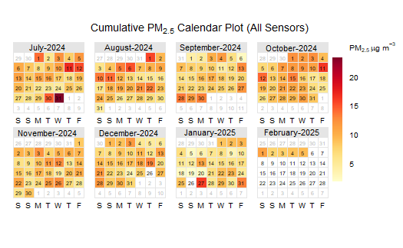
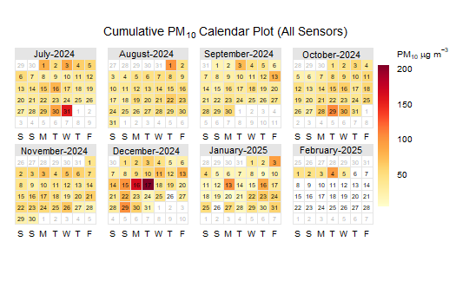
calendarPlot (pm2.5)

Slide 11
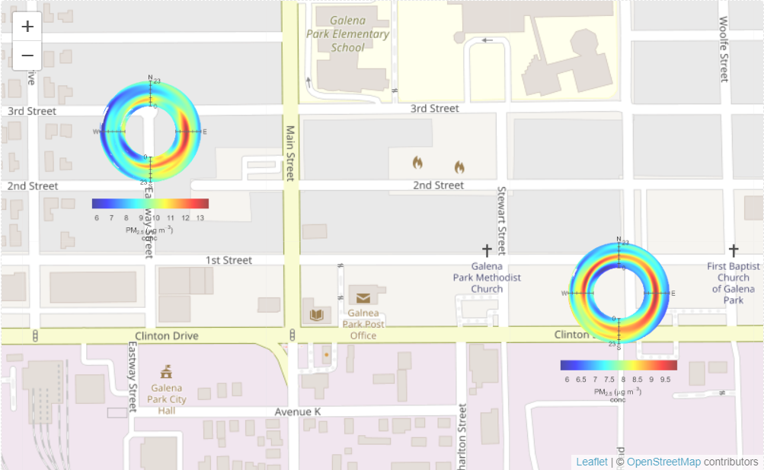
polarMap pm2.5 Annulus

Slide 12
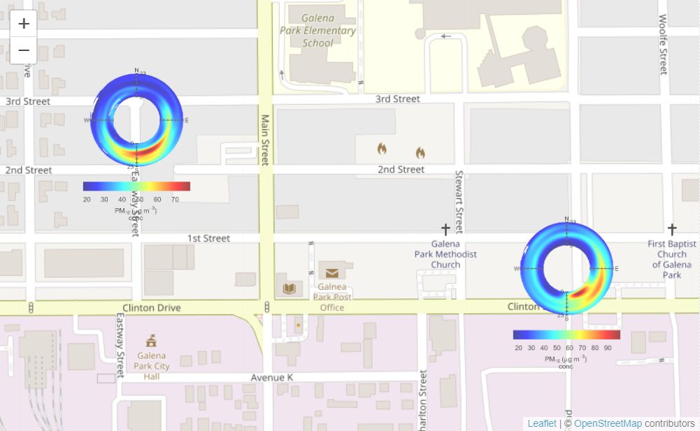
polarMap pm10

